Slide 1

Energy Consumption Analysis

Slide 2
About me
I have completed my Bachelor’s of Technology in Computer Science and Engineering with a specialization in Data Science.
Being a fresher, I don’t have formal industry experience yet, but I have worked on multiple academic and internship projects focused on data cleaning, preprocessing, analysis, and visualization.
I also completed my internship in Data Quality & Data Analytics, where I gained hands-on experience with Python, SQL, Power BI, and real-world datasets.
I am passionate about exploring data, building dashboards, and generating meaningful insights that support decision-making.
LinkedIn – https://www.linkedin.com/in/ganesh-gollapalli-928856275
GitHub – https://github.com/Ganesh8217/SQL-PROJECT

Slide 3
Agenda:
Objective of the Project
ER Diagram and schema explanation
Key analysis questions (use cases)
SQL query results with screenshots or summaries
Final business insights and recommendations
Conclusion (Key finding overall)
Q&A Slide
Your Experience/Challenges working on SQL – Data Analysis Project.

Slide 4
Objective of the Project:
To analyze the relationship between energy production and energy consumption.
To determine per capita energy consumption trends.
To compare economic growth (GDP) with emissions and consumption patterns.
To identify countries with unusual energy profiles (e.g., high production but low consumption or vice versa).
To use SQL queries for extracting, aggregating.

Slide 5
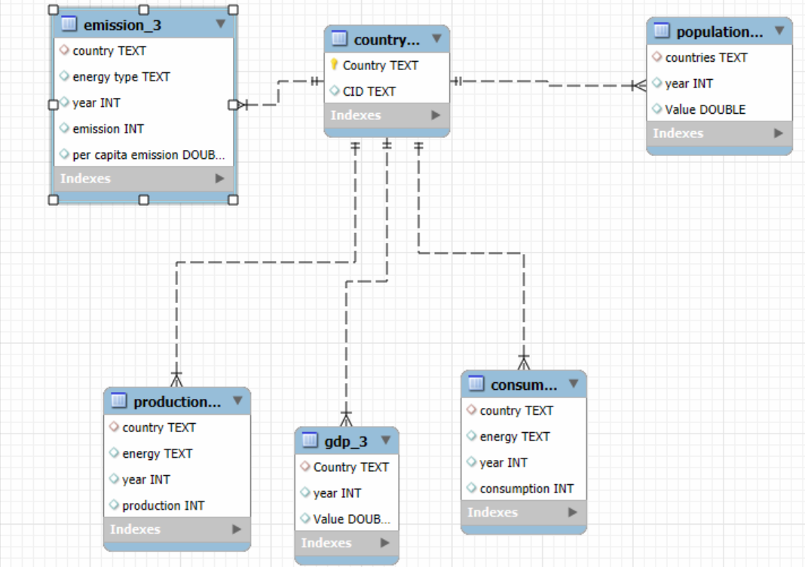
ER Diagram and schema explanation

Slide 6
Key analysis questions :
General & Comparative Analysis
Trend Analysis Over Time
Ratio & Per Capita Analysis
Global Comparisons

Slide 7
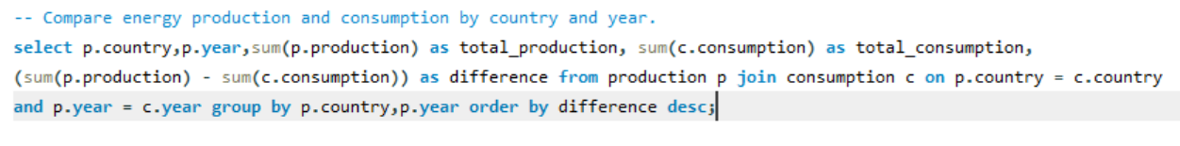
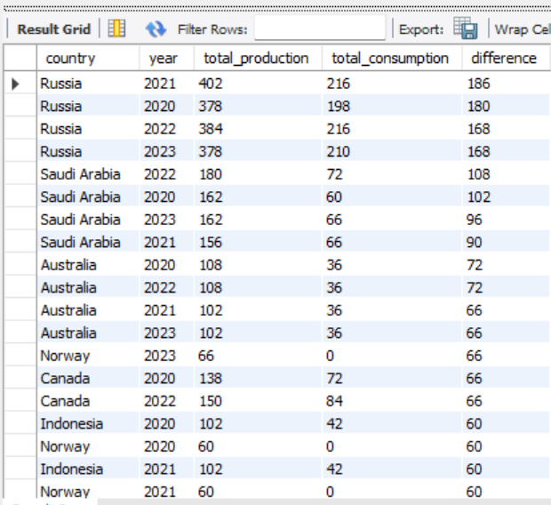

Slide 8
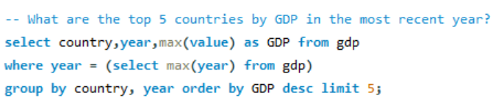
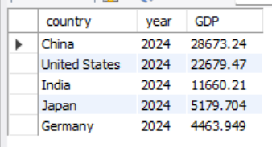

Slide 9
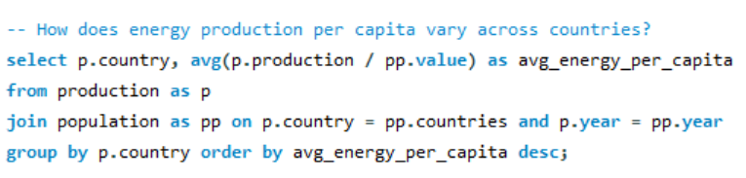
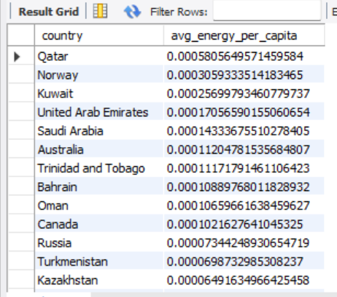

Slide 10
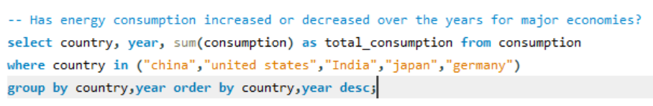
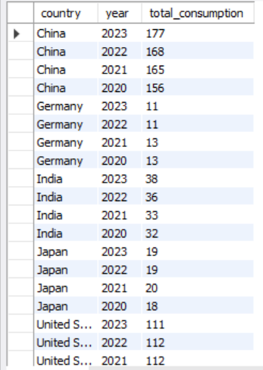

Slide 11
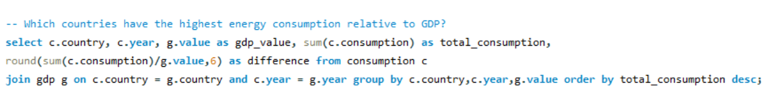
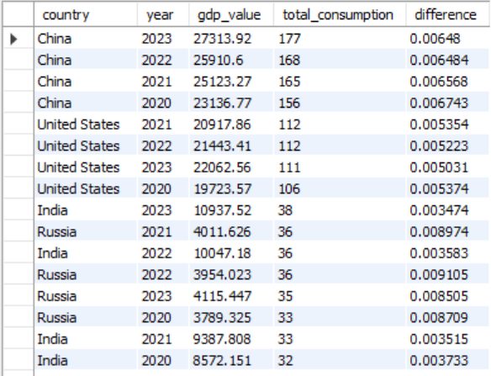

Slide 12
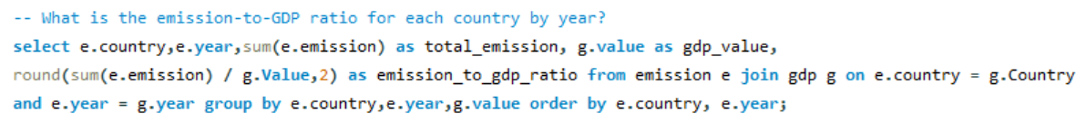
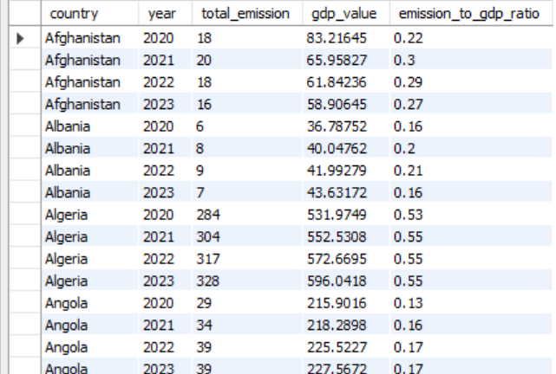

Slide 13
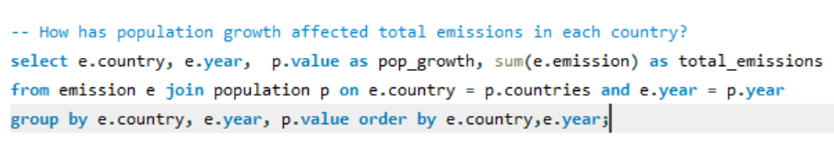
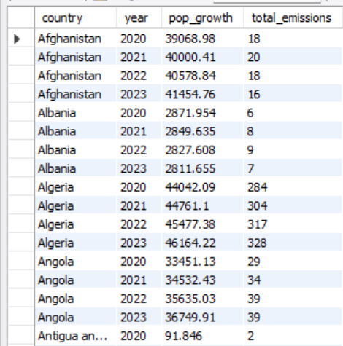

Slide 14
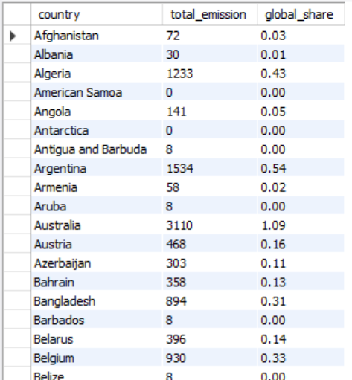

Slide 15
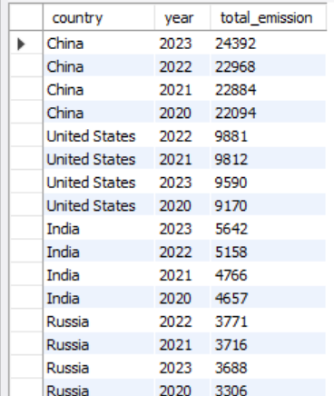

Slide 16
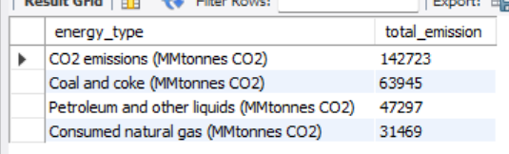

Slide 17
Business insights:
Countries with high GDP but low renewable production indicate potential for sustainable energy investments.
Per capita energy consumption strongly correlates with GDP, but emissions efficiency varies widely — some high consumers maintain lower emissions per capita.
Emerging economies show rising consumption rates, signaling future market demand for energy solutions.
Nations with stable or declining emissions despite GDP growth showcase effective environmental policies worth replicating.

Slide 18
Recommendations:
Encourage policy adoption from low-emission high-GDP countries to improve efficiency.
Invest in renewable infrastructure in high consumption but low production regions.
Implement data-driven monitoring systems for early detection of unsustainable trends.
Promote international collaboration on clean energy tech to close the production-consumption gap.
Prioritize public awareness and energy efficiency programs in rapidly growing economies.

Slide 19
Experience Gained:
Strengthened SQL skills by working with complex joins, subqueries, and aggregations.
Learned to derive actionable insights from multi-table datasets.
Improved data cleaning & transformation skills to ensure query accuracy.
Gained experience in real-world energy analytics and interpreting per capita emissions and GDP impact.

Slide 20
Challenges Faced:
Handling inconsistent data formats across multiple tables (e.g., missing or mismatched country names).
Balancing query performance while using multiple joins and aggregations.
Ensuring data completeness before making business recommendations.
Translating raw numbers into clear, meaningful insights for non-technical audiences.

Slide 21
Conclusion:
This SQL project highlights the power of relational databases in energy data analysis. By integrating production, consumption, GDP, population, and emissions data, we can uncover:
Regions leading in production and consumption.
Disparities in per capita energy access.
Economic implications of energy usage.
Environmental costs of energy generation.
Such insights can guide sustainable energy policies, investments in clean energy, and equitable distribution of resources.

Slide 22

THANK YOU

